Slide 1

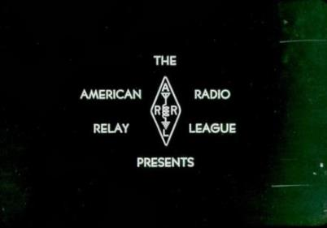



THE HQ HISTORICAL COMMITTEE TEAM PRESENT
”THE HISTORY OF W1AW”

Slide 2
WELCOME TO THE
WORLD OF ARRL
On the threshold of a new century

Slide 3
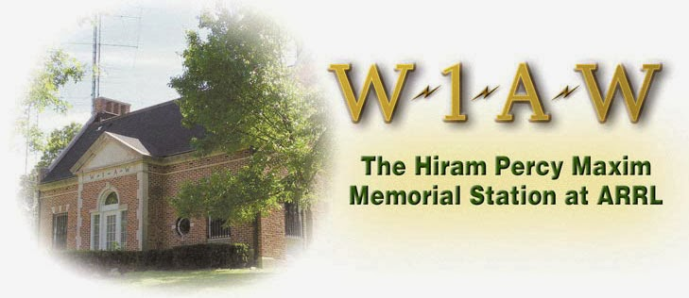

Slide 4
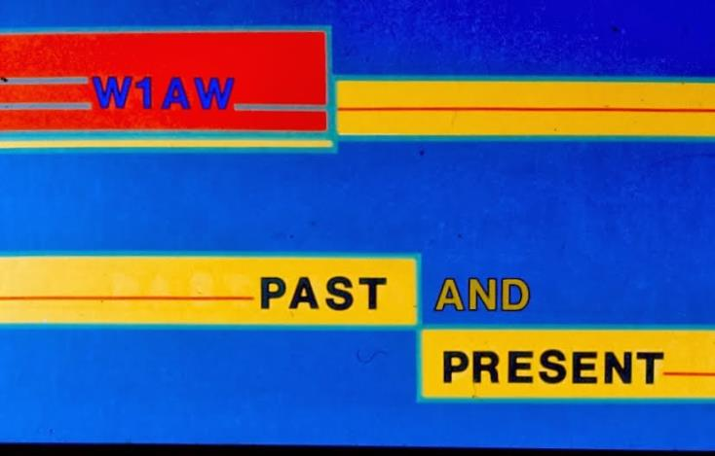
W1AW

Slide 5
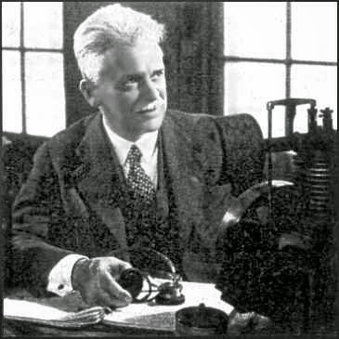
ARRL FOUNDER
Hiram Percy Maxim

Slide 6
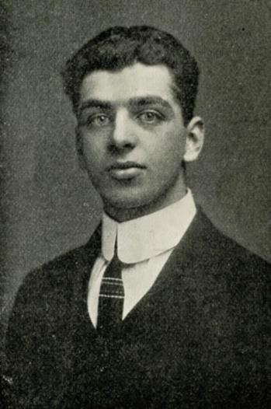
ARRL CO-FOUNDER
Clarence D. Tuska

Slide 7
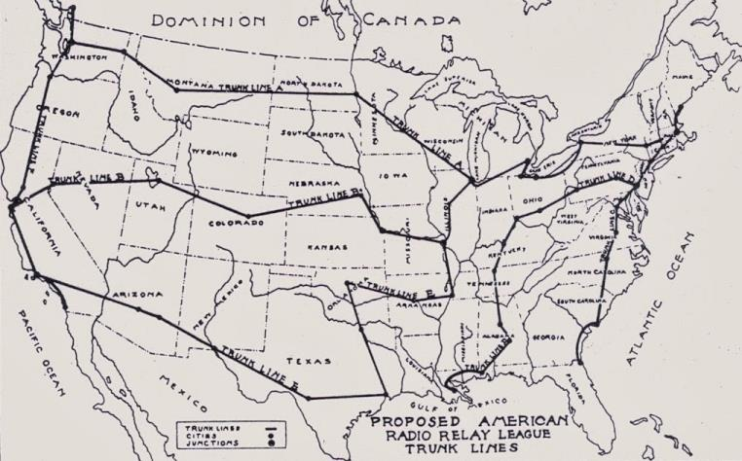
THE CONCEPT OF THE LEAGUE
Proposed ARRL Relay Routes

Slide 8
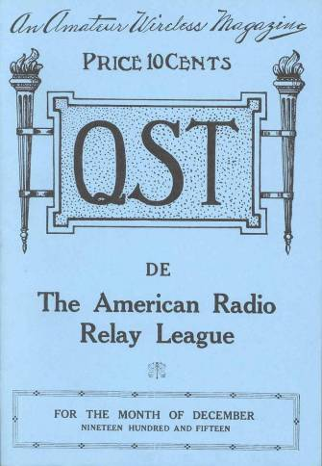
FIRST ISSUE OF QST
The Uniting Membership Journal

Slide 9


Happy 100th Birthday QST!

Slide 10
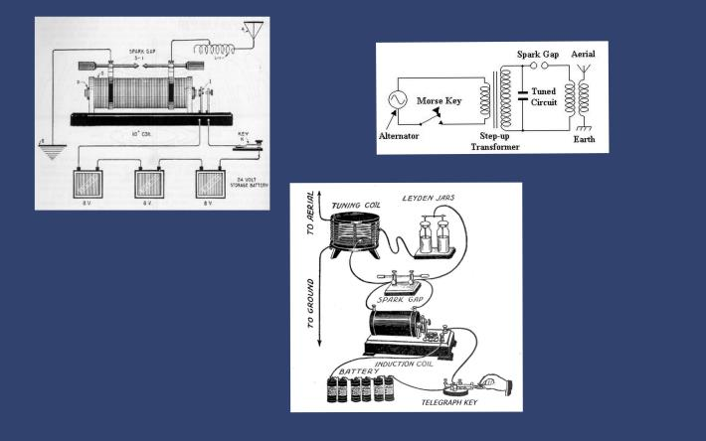

SPARK GAP TRANSMITTER
A Early Method of Generating Electromagnetic Waves

Slide 11
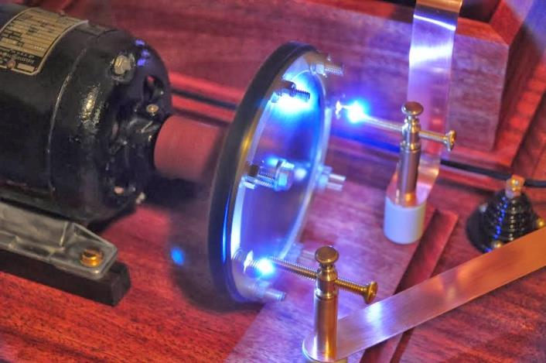
King Spark

Slide 12
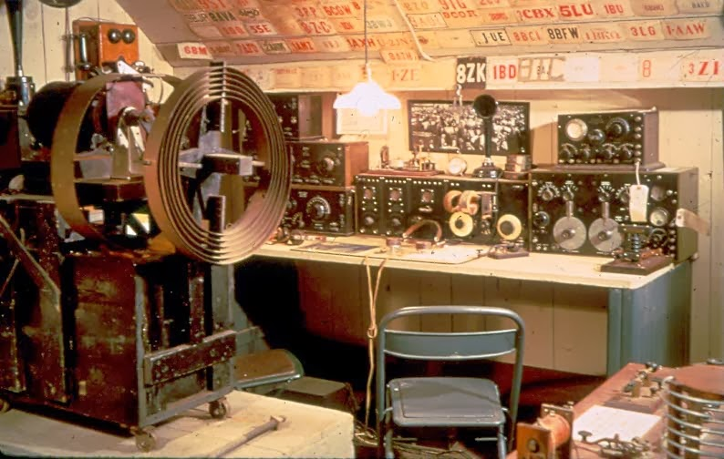
Enormous Spark Gap Station

Slide 13
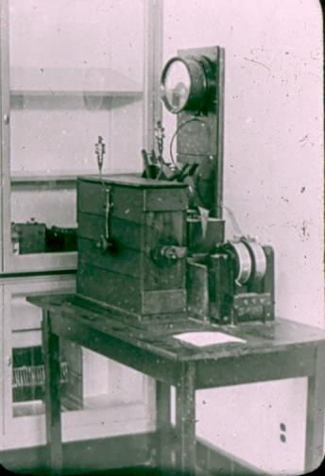
“OLD BETSY”
Maxim Spark Transmitter

Slide 14
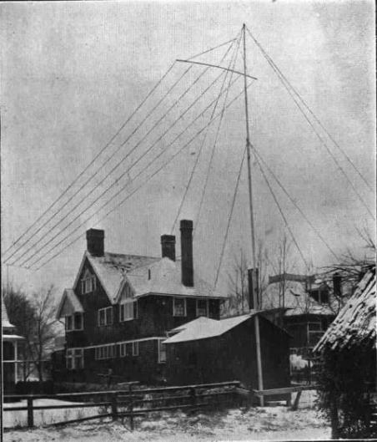
MAXIM QTH ANTENNA
Hartford, Connecticut

Slide 15
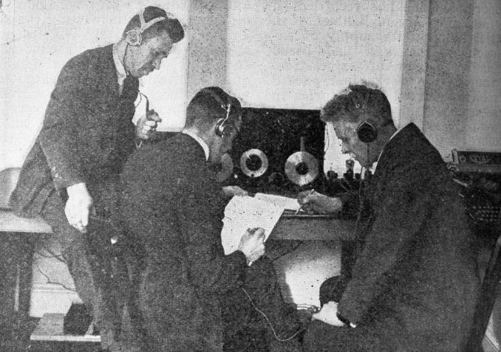
U.S. JUDGES LISTENING
Warner, Schnell and Maxim

Slide 16
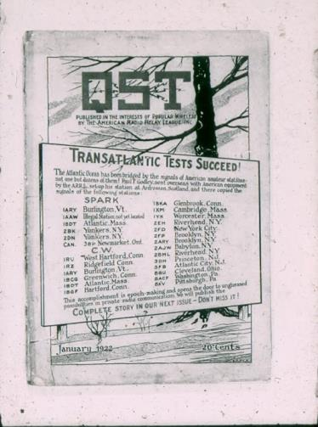
TRANSATLANTIC TEST
DECEMBER 1922
Successful Second Attempt

Slide 17
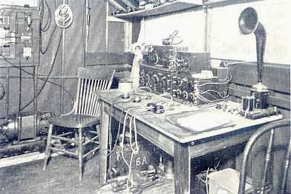
1BCG ▪ CONNECTICUT
Receiver at Successful Station

Slide 18
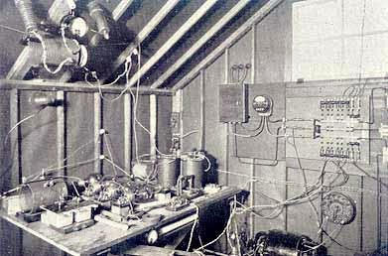
1BCG ▪ CONNECTICUT
CW Transmitter

Slide 19
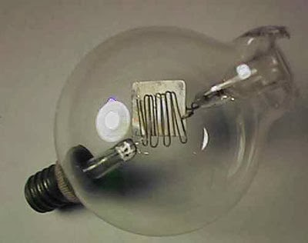
CW AND THE VACUUM TUBE
Assume the Throne

Slide 20
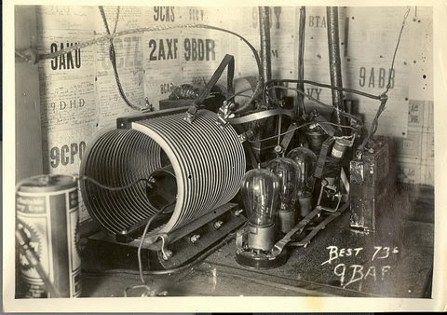
CW & THE VACUUM TUBE
Early Tube Transmitter

Slide 21
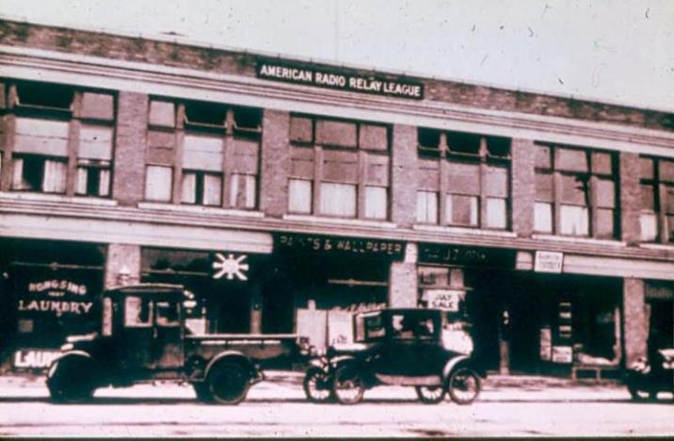
HARTFORD 1925
ARRL Second Location

Slide 22
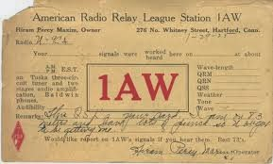
1AW
Maxim Acquires Call Sign

Slide 23
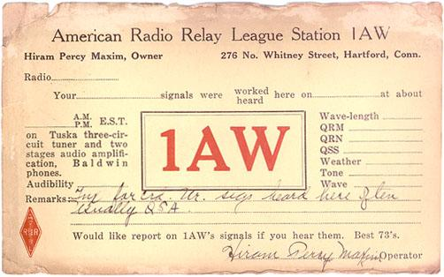
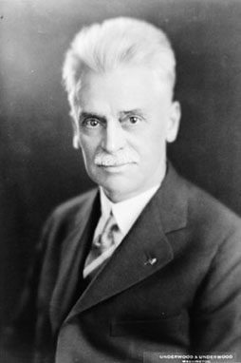

Hiram Percy Maxim
1869 - 1936

Slide 24
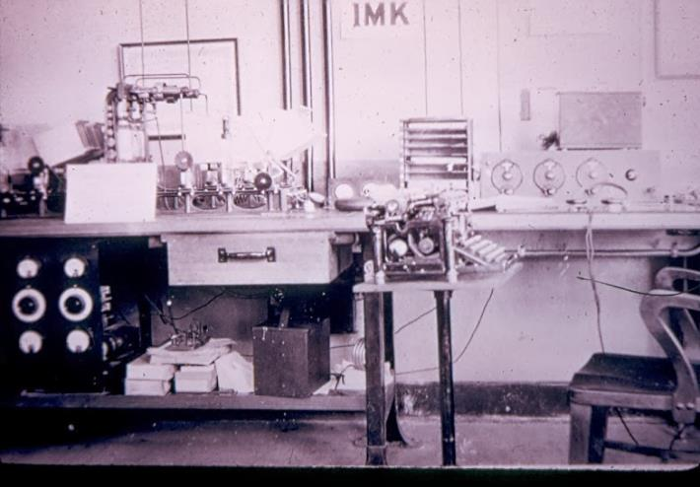
HQ STATION W1MK
Brainard Airfield, Hartford

Slide 25
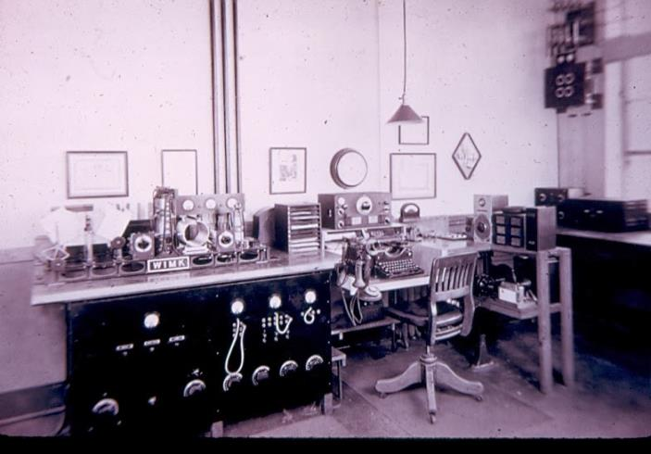
HQ STATION W1MK
Later HQ Station

Slide 26
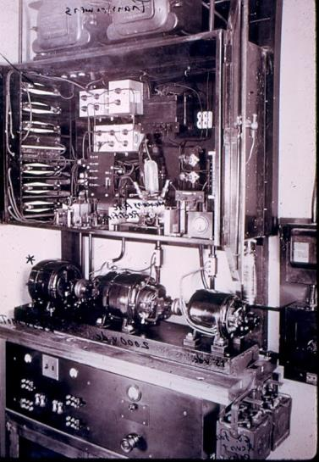
W1MK
Power Supply

Slide 27
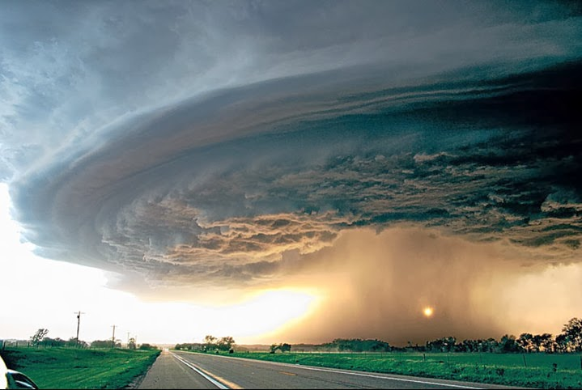
NEW ENGLAND 1936
Big Storms ▪ Big Floods

Slide 28
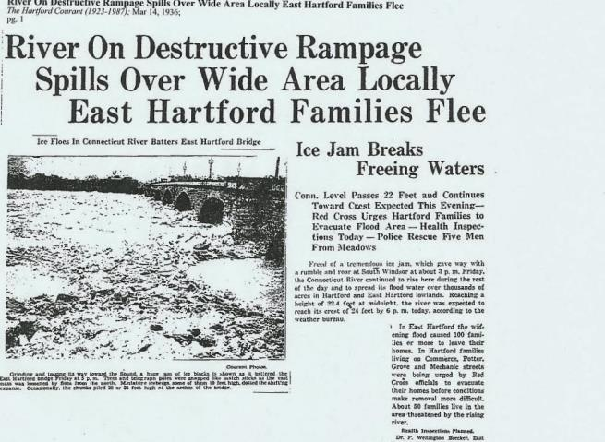
RIVER CRESTS AT 24 FEET
Hartford, Connecticut

Slide 29
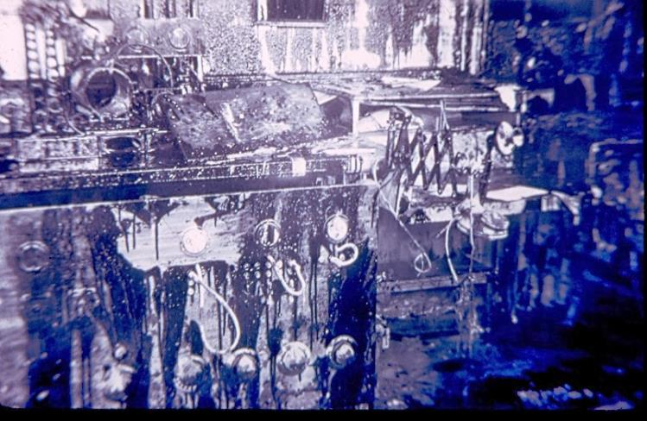
W1MK
Destroyed

Slide 30
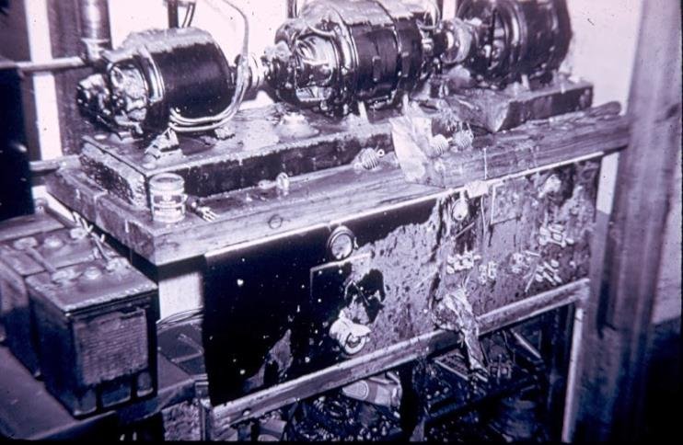
WATER & OIL
Ruinous Effects

Slide 31
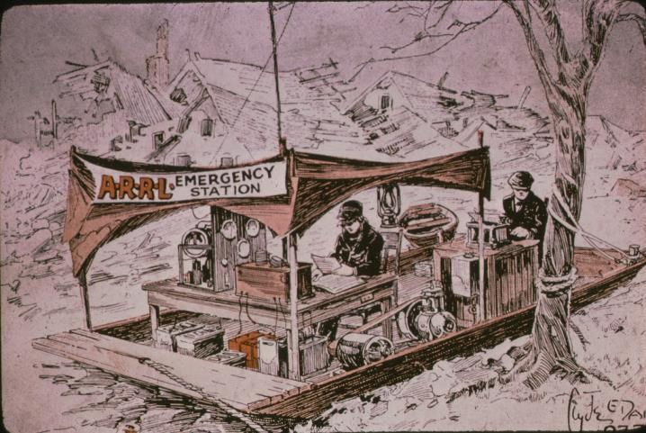
QST CARTOON
Flood Barge Mobile

Slide 32
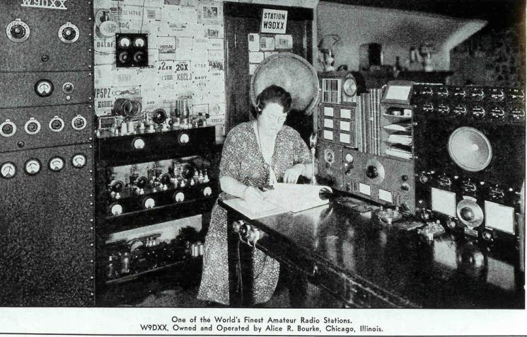
WHERE IS W1MK?
Alice R. Bourke, W9DXX

Slide 33
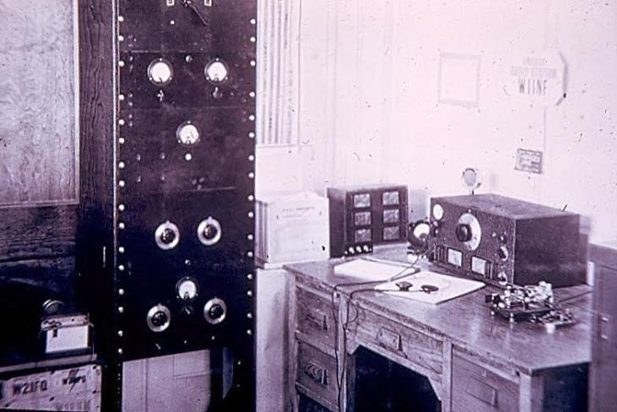
W1INF
First Temporary HQ Station

Slide 34
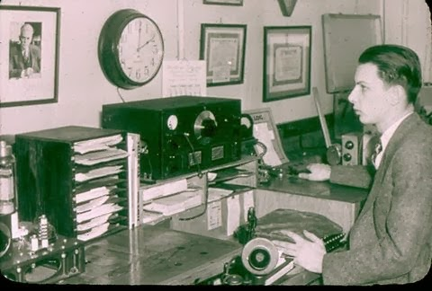
INTERIM HQ STATION
Assumes Call Sign W1AW

Slide 35
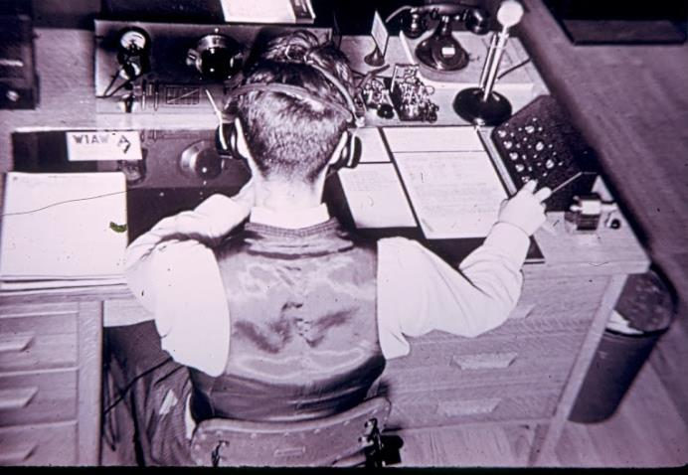
INTERIM W1AW

Slide 36
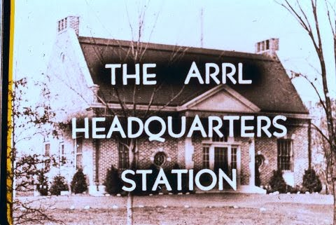
ARRL HQ STATION

Slide 37
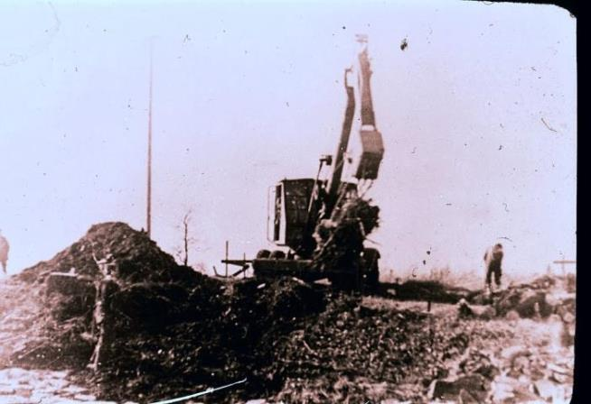
BREAKING GROUND
NEWINGTON, CONNECTICUT
Site of New HQ Station, 1937

Slide 38
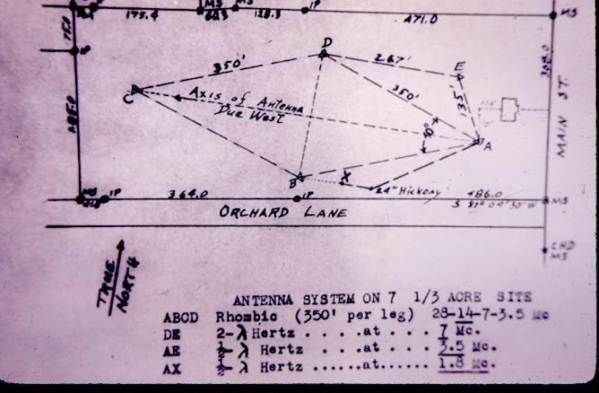
HUGE RHOMBIC ANTENNA
Plan for the Antenna

Slide 39
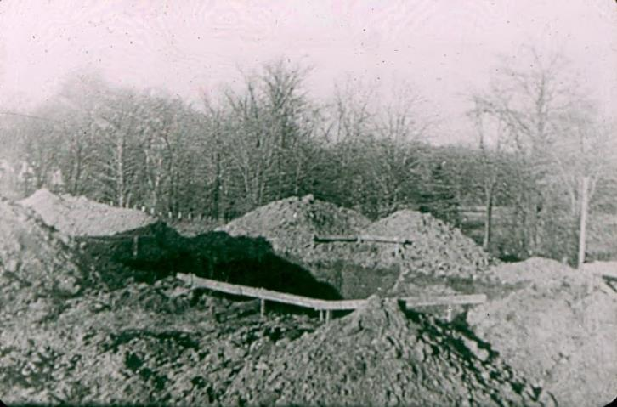
NEWINGTON, CONNECTICUT
Orchard Lane at Main Street

Slide 40
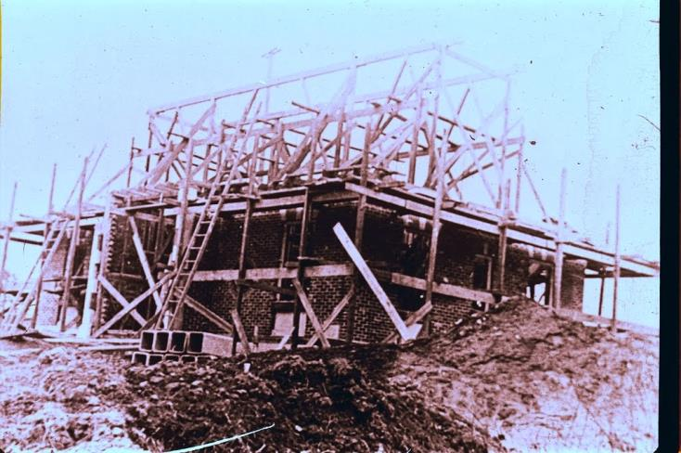
GROWING STRUCTURE

Slide 41
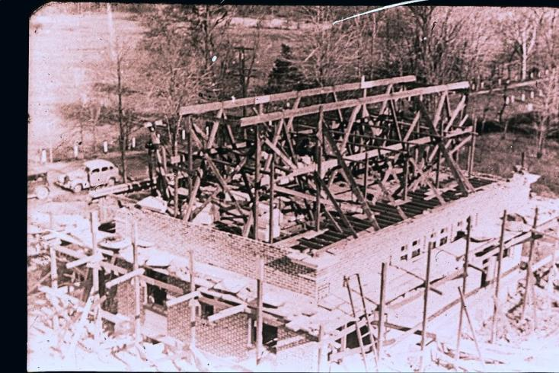
GROWING STRUCTURE

Slide 42
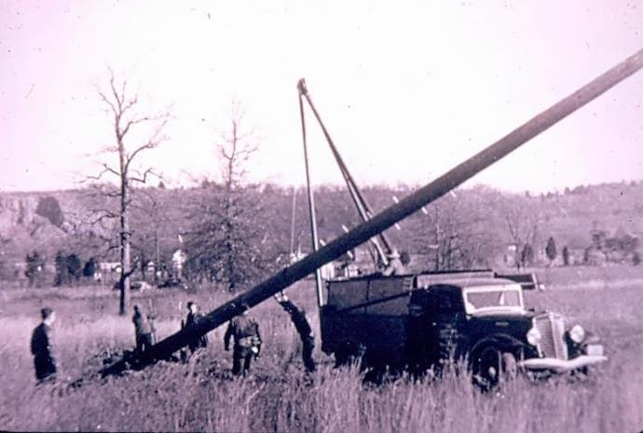
SETTING ONE OF THE
ANTENNA MASTS

Slide 43
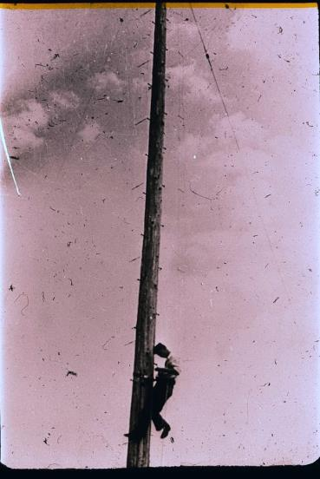
CLIMBING TO RUN WIRE ELEMENTS

Slide 44
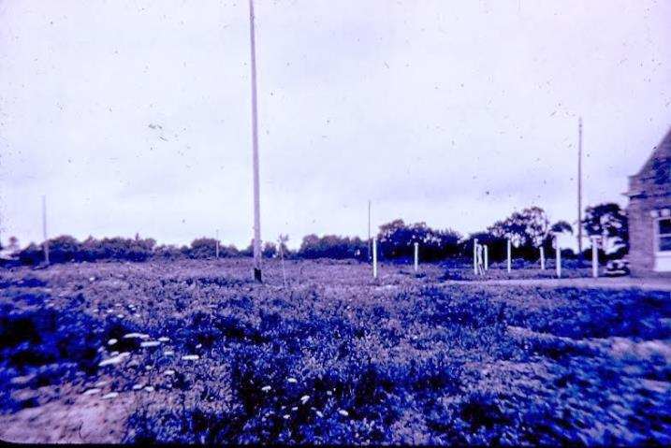
MASTS & FEEDLINE SUPPORTS

Slide 45
MASTS & FEEDLINE SUPPORTS

Slide 46
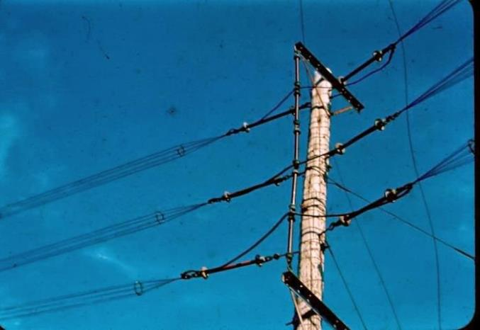
MAST –ANTENNA JUNCTIONS

Slide 47
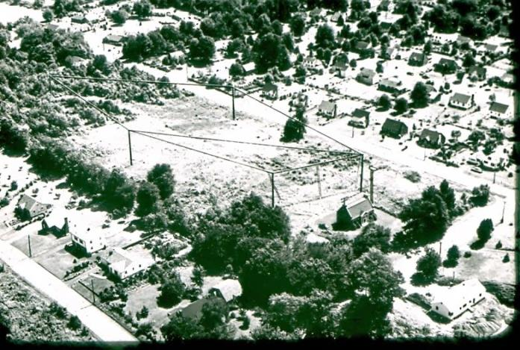
STATION & ANTENNA
Enhanced Aerial View

Slide 48
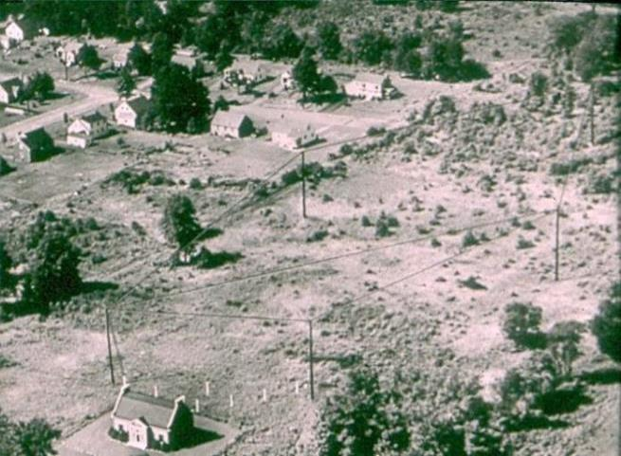
STATION & ANTENNA
Enhanced Aerial View

Slide 49
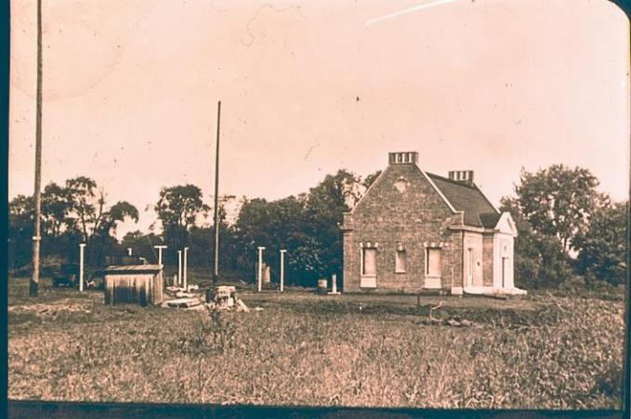
NEARLY COMPLETED BUILDING
Plus, Masts and Feed Line Supports

Slide 50
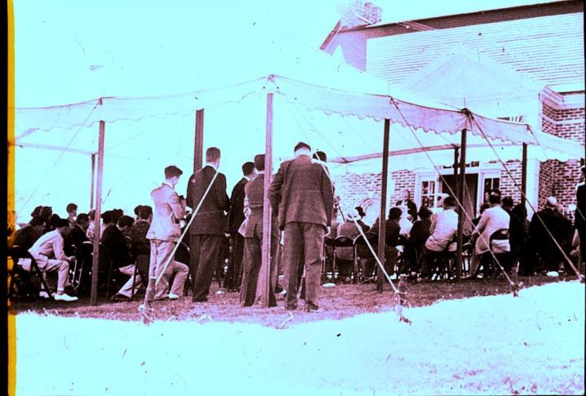
DEDICATION CEREMONY
1938

Slide 51
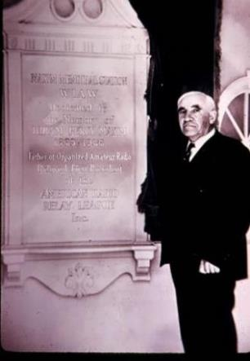
ARRL PRESIDENT
DR. EUGENE C. WOODRUFF, W8CMP
Unveils the Building Plaque September 1938

Slide 52
ARRL HQ STATION

Slide 53
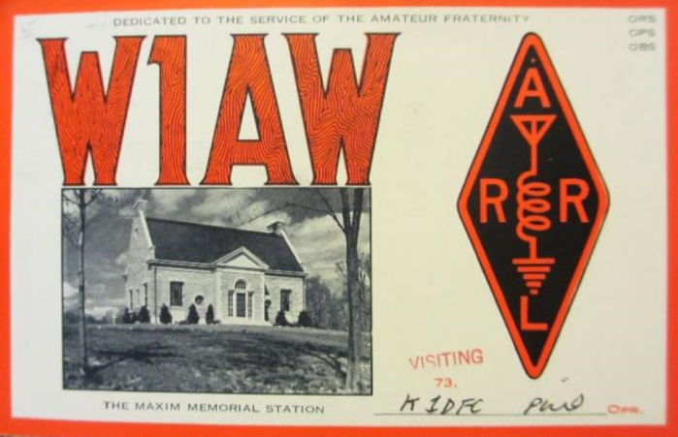
W1AW

Slide 54

OLD BETSY’S NEW HOME

Slide 55

EARLY STATION
Transmitter Racks

Slide 56

EARLY OPERATING POSITION
George Hart, W1NJM

Slide 57

FULL VIEW OF RADIO ROOM

Slide 58

ANOTHER VIEW

Slide 59

MURRAY POWELL W1QIS
Station Manager at Operating Desk

Slide 60

CONTROLS ON DESK
Murray Powell & Chuck Bender, W1WPR

Slide 61

POWELL & BENDER
Operating Position in W1AW Basement

Slide 62

ADDITIONAL RECEIVERS

Slide 63

HEATH GEAR TESTING

Slide 64

WORLD WAR TWO

Slide 65

Training CW Operators

Slide 66

ORBITING SATELLITE CARRYING AMATEUR RADIO
OSCAR 1, First Amateur Satellite, 1961

Slide 67

OSCAR 2
1962

Slide 68

NEW LICENSE CLASSES CREATED
Novices & Technicians Begin Operating; July 1951

Slide 69

ARRL 50TH ANNIVERSARY
1964

Slide 70

VIEW OF GROUNDS
Artist’s Conception

Slide 71

NEWINGTON 1962
Ground Breaking for HQ Building

Slide 72

CONSTRUCTION

Slide 73

VIEW FROM MAIN STREET

Slide 74

AERIAL VIEW
Rhombic Visible

Slide 75

OWEN GARRETT W5LFL
First Amateur in Space, 1983

Slide 76

PROGRESSING TO THE CURRENT ERA

Slide 77

RHOMBIC REPLACED BY YAGIS

Slide 78

ANY BAND

Slide 79

ANY MODE

Slide 80

LOCAL

Slide 81

DX

Slide 82

COLLINS S-LINE EQUIPMENT
Bill Owen, W1EES at Console

Slide 83

UPDATED TRANSMITTERS

Slide 84

COLLINS CONSOLE
With Transmitter Racks

Slide 85

CODE PRACTICE TAPE SET UP
Chuck Bender, W1WPR Cutting Tape

Slide 86

BULLETIN COMING
Bill Owen, W1EES
Sending Tape

Slide 87

OPERATING POSITION VIEW
With Tape Player

Slide 88

1979 BULLETIN
Keeping All Informed k

Slide 89

W1AW TODAY
Jack Ciaccia, WM0G Visiting
The Ultimate Radio Station
jV

Slide 90

W1AW TODAY
Station Manager Joe Carcia
NJ1Q At Main Control Console
j

Slide 91

W1AW TODAY
Studio One: Mike Corey, KI1U at Contest Station

Slide 92
W1AW TODAY
Studio Two: APRS, Packet, and Satellite Stations

Slide 93
W1AW TODAY
Studio Three: Three Transceivers with Amplifiers

Slide 94
W1AW TODAY
Principal Broadcast Equipment

Slide 95

THANKS

Slide 96
CREATED BY:
MICHAEL MARINARO, WN1M
Advised By:
Bob Allison, WB1GCM
Jonathan Allen, K2KKH
Joe Carcia, NJ1Q
THE ARRL BOARD OF DIRECTORS – HISTORICAL COMMITTEE

